Slide 1
DotAsia AGM 2013
APRICOT Singapore | 2013.02.24

Slide 2
Agenda:
Welcome Remarks
DotAsia Operations in 2012
Audited Financials (Fiscal Year 2011-2012)
Community & Special Projects
.Asia Registry Technical Updates (Afilias)
DotAsia Strategic & Operational Plans 2013
Member Resolutions (Board Elections)
Open Discussion & Closing Remarks

Slide 3
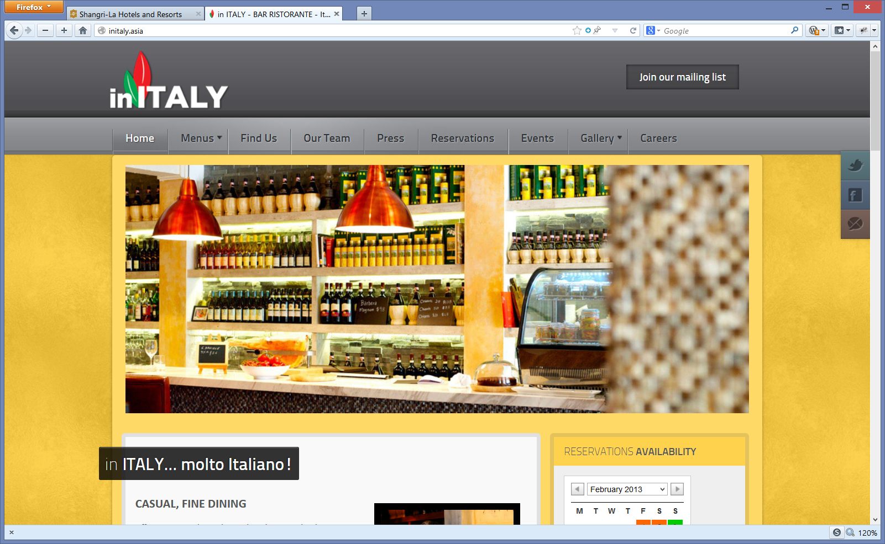
Joint AP* DotAsia Dinner
6:00PM @ Shangri-La Lobby
www.inITALY.asia

Slide 4
First 5 Years of .Asia

Slide 5
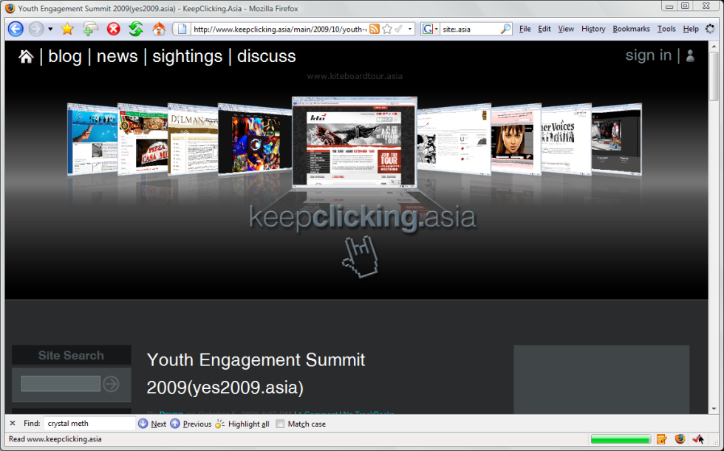
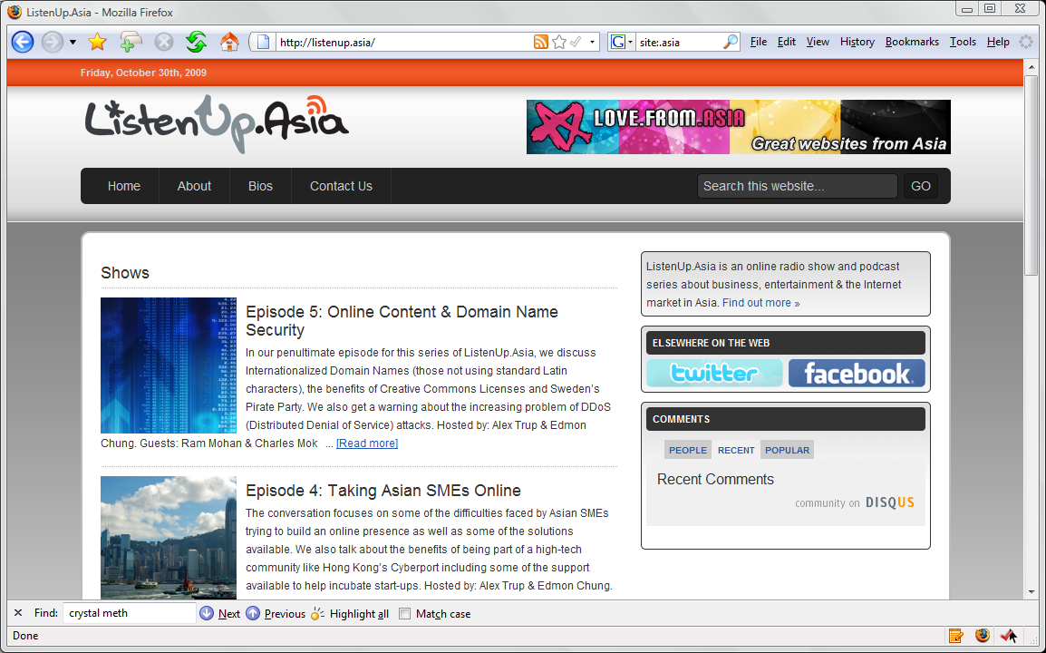
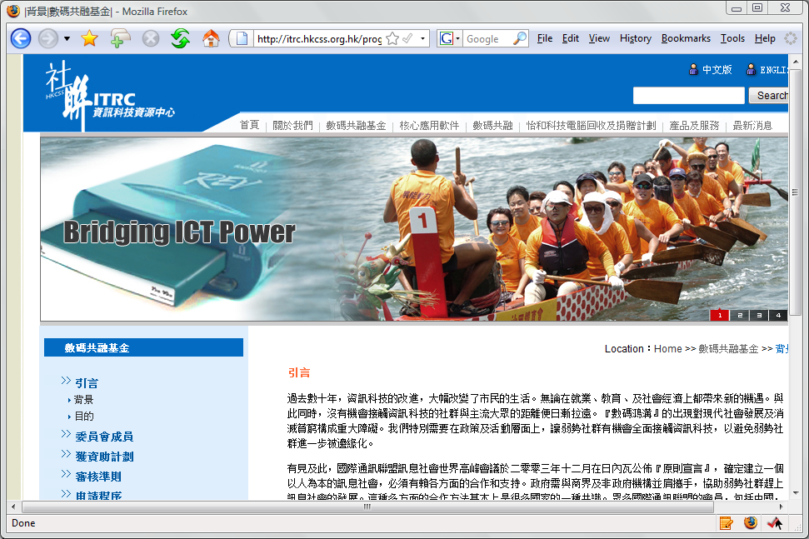
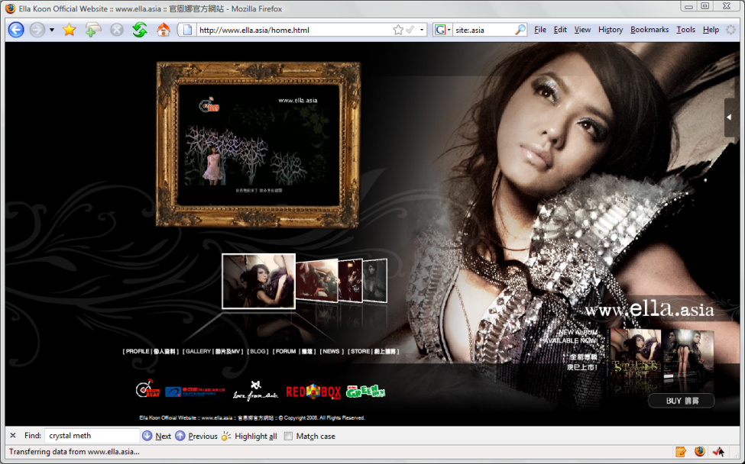
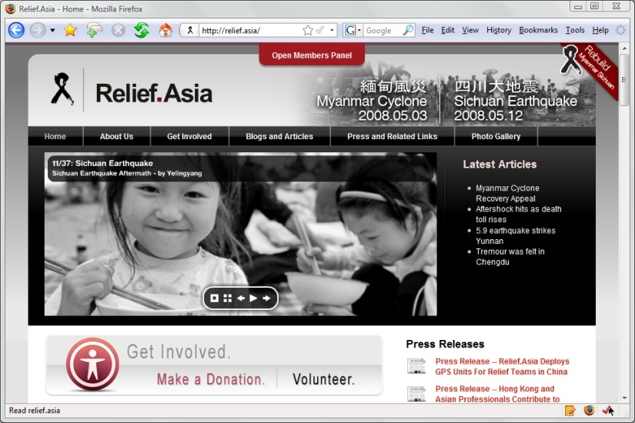
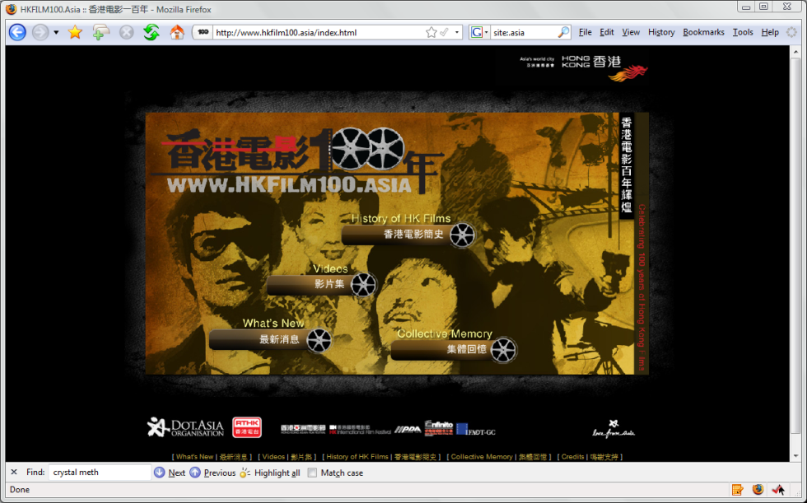
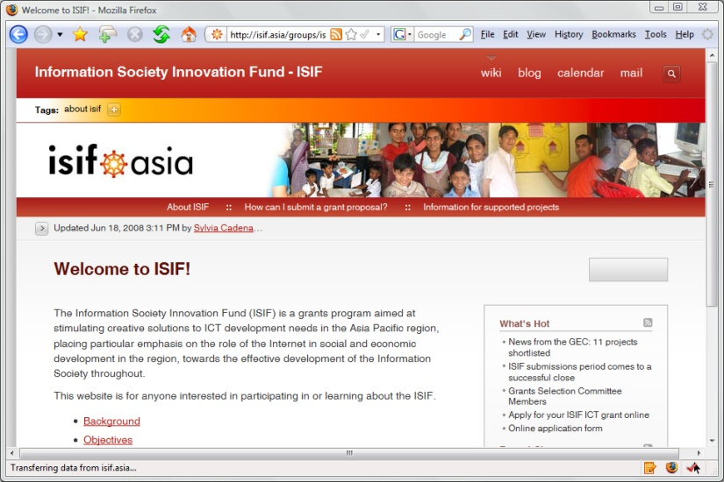
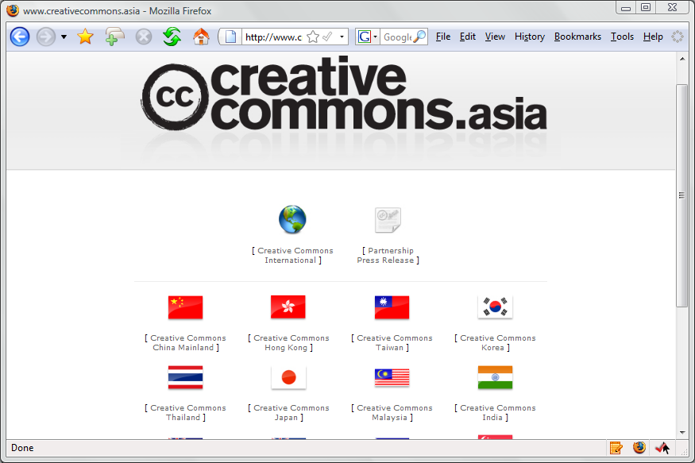
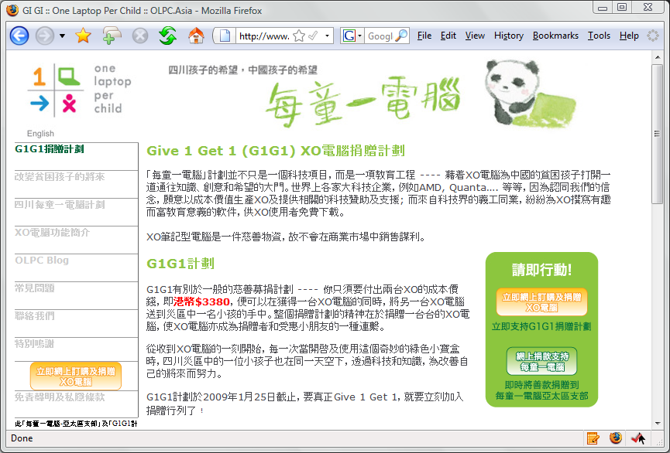


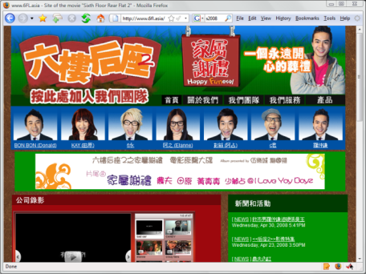
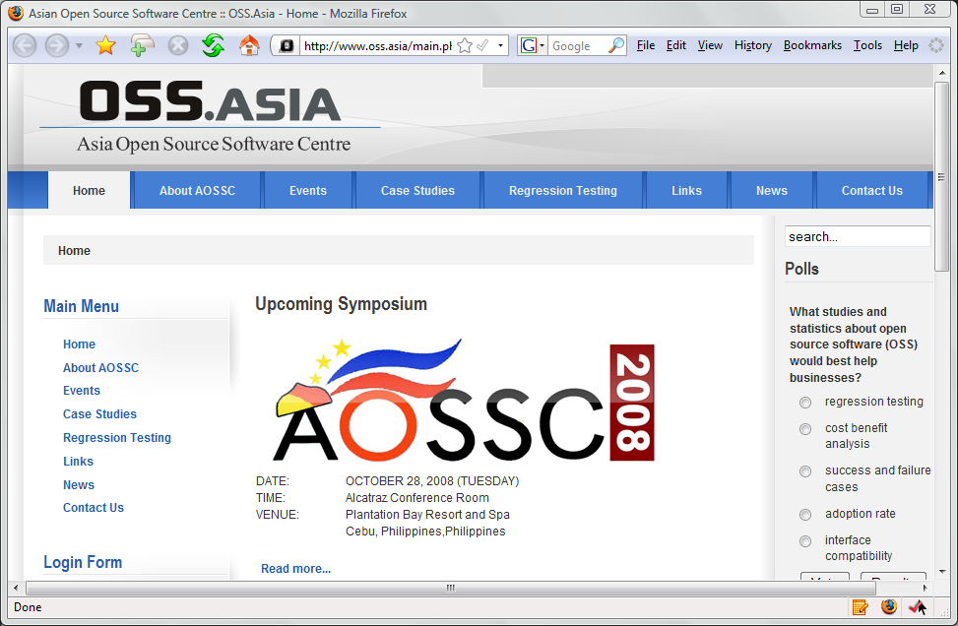
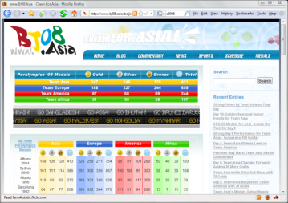

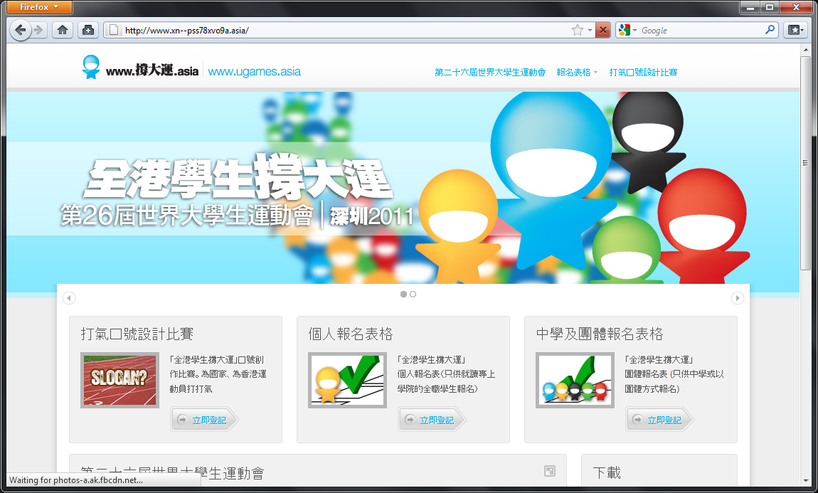
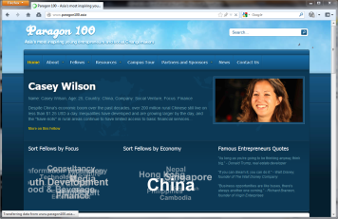
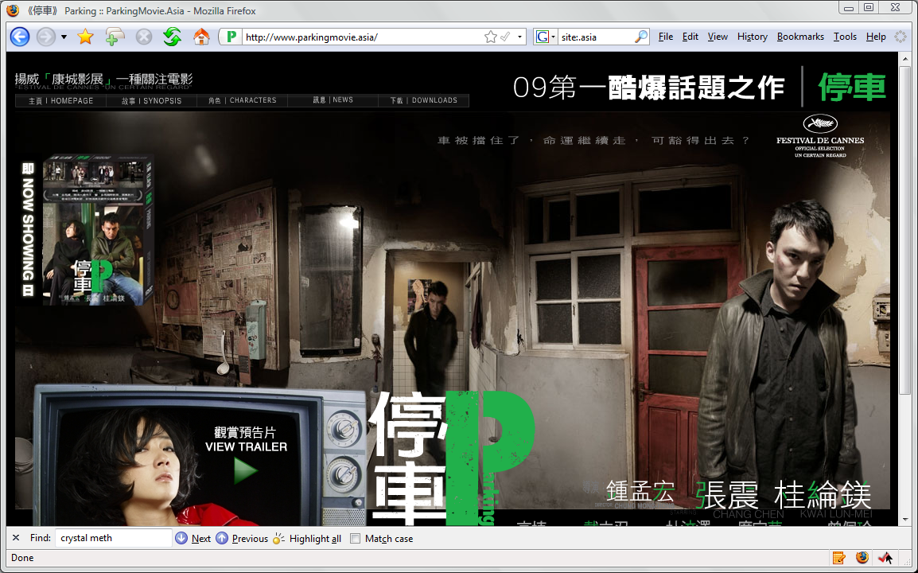
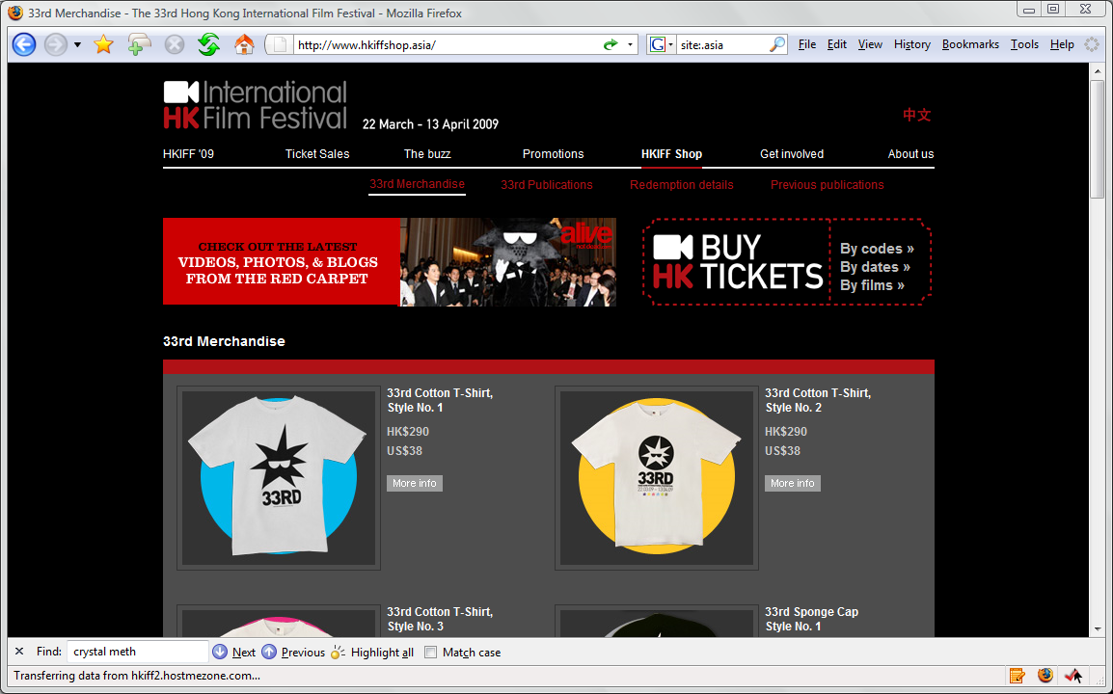

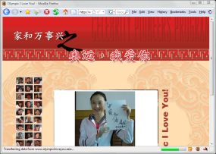
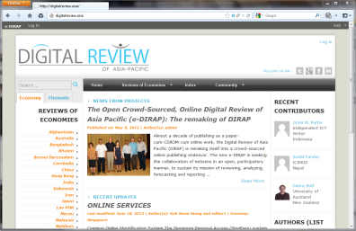


Slide 6


Slide 7

CJK IDN GoLive: June 21, 2012

Slide 8
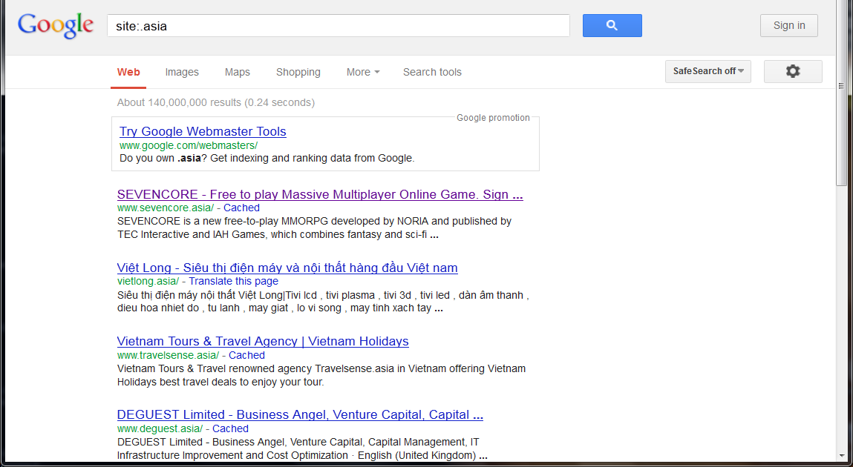
Growing .Asia Presence
2009: 13 Million
2011: 66 Million
2012: 85.8 Million
2013: 140 Million entries indexed at Google

Slide 9
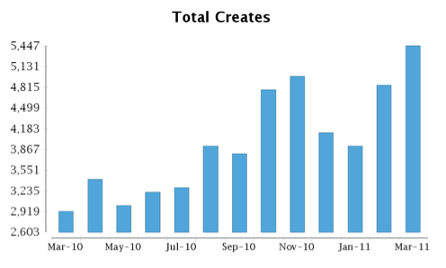
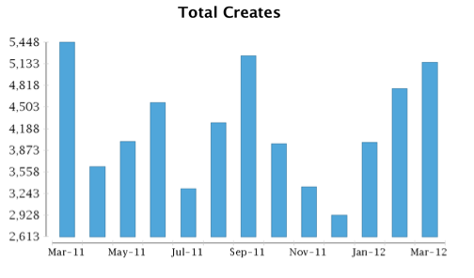
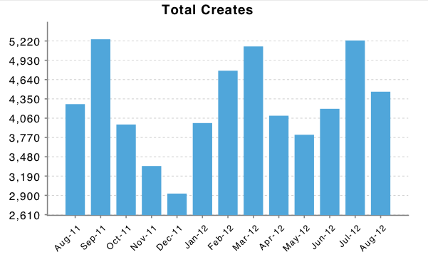
2010 to 2012 .ASIA Promtions
BPP (Base Price)
ASAP (Super Achiever)
.ASIA FreeB Promo
Notes:
Efforts and promos to market .ASIA to registrars and their customers by testing different price points.
Since 2010 we ran a series of price discount promos, in the form of rebates. Registrars were given targets, ie. x% of gain from a base volume, the base volume is consisted of either monthly average of the same month a year ago, or average of previous promo gains. The goal of these promos were to bring down street prices of .ASIA for consumers, prior to the promos .Asia domains were sold for $19.99 USD or higher. During the price promo .Asias were available to registrants for as low as $5 and even lower for resellers.
We’ve achied 30% growth between 2009 and 2010, and another 18% increase between 2010 and 2011. To put this in domians, our 2009 monthly ave new creates were a modest 2,650, by 2011, our monthly average new create surpassed 4,000 Domains a month.

Slide 10


Free 7” Android Tablet
With Every 10 Year .Asia Registration

Slide 11
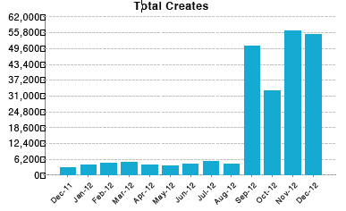
Sep 2012 .ASIA Anniversary Promo
Notes:
In terms of number of new creates FreeB .ASIA did not do as well as the other promos.
On Sep 1st we started our most price aggressive promo, the .ASIA Anniversary promo at $0.75 for first year registrations
At the end of September we received 50, 441 domains, ten times as much as our highest number of new creates in 2011. This is what brought our registrations from 200, 000 to 250,000 in a month and now to over 400,000 domains under management

Slide 12
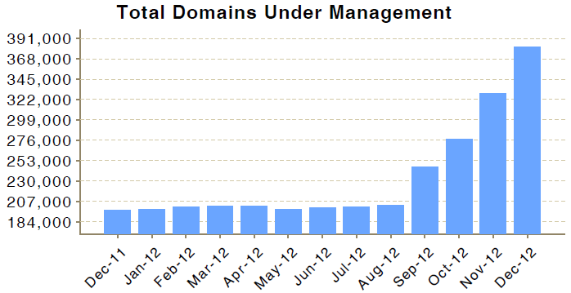
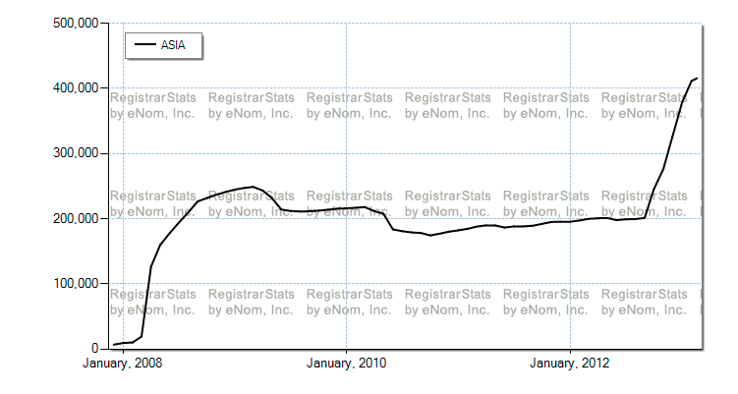
420,000+ Registered Domains
Rapid Growth in Adoption stimulated by lower price-based promotion
Historical Growth from 2008 Go Live

Slide 13
Top .ASIA Registrars 2011 vs. 2012
2011
2012
GoDaddy.com
Aust Domains
Network Solutions
Directi
Key-Systems
18%
12%
9%
7%
5%
US
AU
US
IN
DE
GMO
Megazone
Aust Domains
Shanghai Meicheng
Directi
1API
GoDaddy
25%
21%
16%
6%
6%
5%
3.5%
JP
KR
AU
CN
IN
DE
US

Slide 14
Top .ASIA Economies 2011 vs. 2012

Slide 15




Increasing Abusive Registrations
Rapid rise in ranking of blocked .asia domains
  #20 in November 2012
  #16 in January 2013
  #13 in February 2013
  Recording ~1.3% of domains (~5,500 of 420K)
Bringing together community to tackle issues
  Accredited Intervener framework
  Domain Registration Abuse & Suspension Policy Forum (Feb 22, 2012: Joint Event with APTLD)
  APCERT & APWG
  Covering other abuses
  Open discussion of issues

Slide 16
Agenda:
Welcome Remarks
DotAsia Operations in 2012
Audited Financials (Fiscal Year 2011-2012)
Community & Special Projects
.Asia Registry Technical Updates (Afilias)
DotAsia Strategic & Operational Plans 2013
Member Resolutions (Board Elections)
Open Discussion & Closing Remarks

Slide 17
Agenda:
Welcome Remarks
DotAsia Operations in 2012
Audited Financials (Fiscal Year 2011-2012)
Community & Special Projects
.Asia Registry Technical Updates (Afilias)
DotAsia Strategic & Operational Plans 2013
Member Resolutions (Board Elections)
Open Discussion & Closing Remarks

Slide 18
New Community Initiatives Launched in 2012

Slide 19
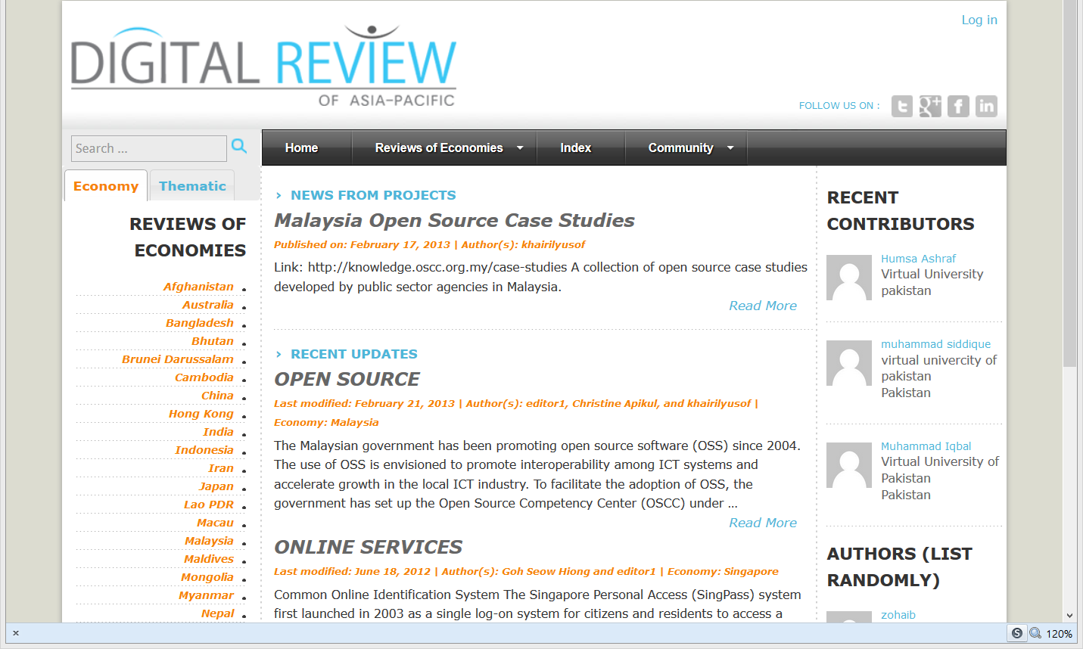
DigitalReview.Asia

Slide 20

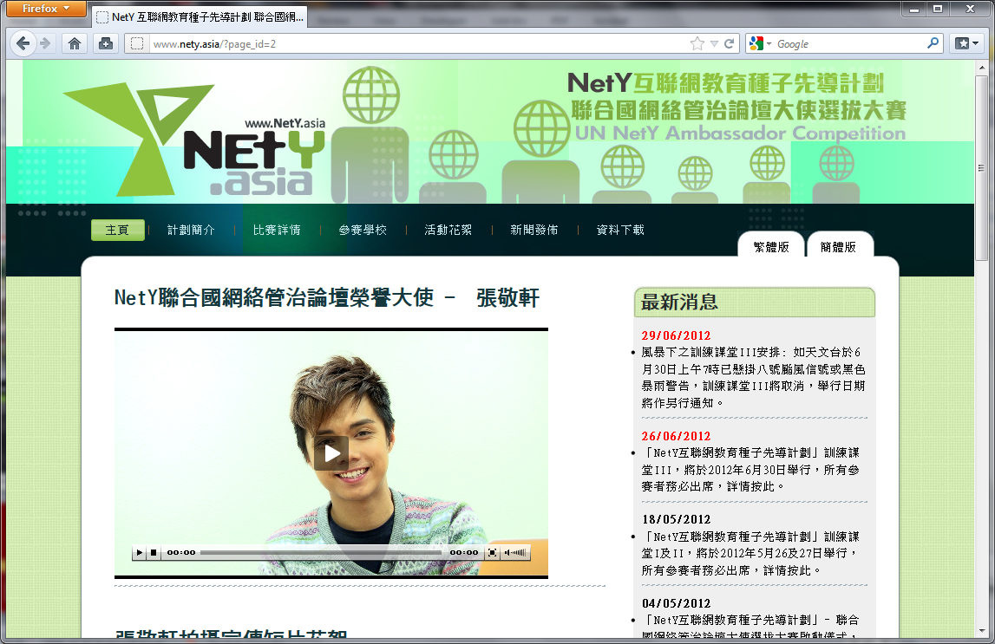

NetY.Asia

Slide 21

FoodRevolutionDay.Asia

Slide 22

MandelaDay.Asia

Slide 23


DonnieYen.Asia for Go.Asia

Slide 24
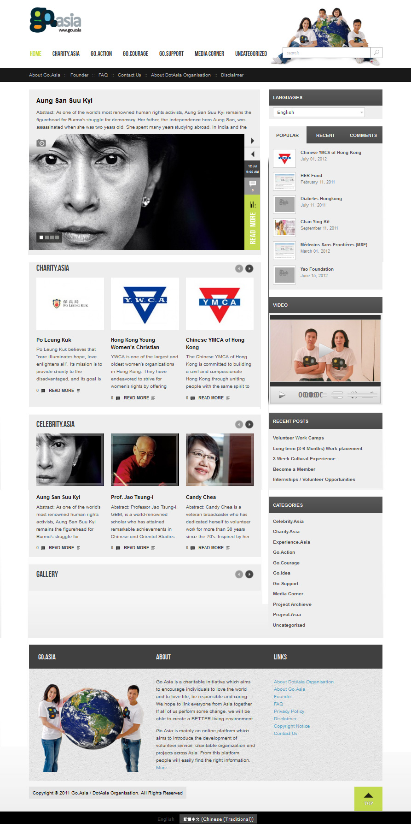

Slide 25
Ongoing Community Projects

Slide 26
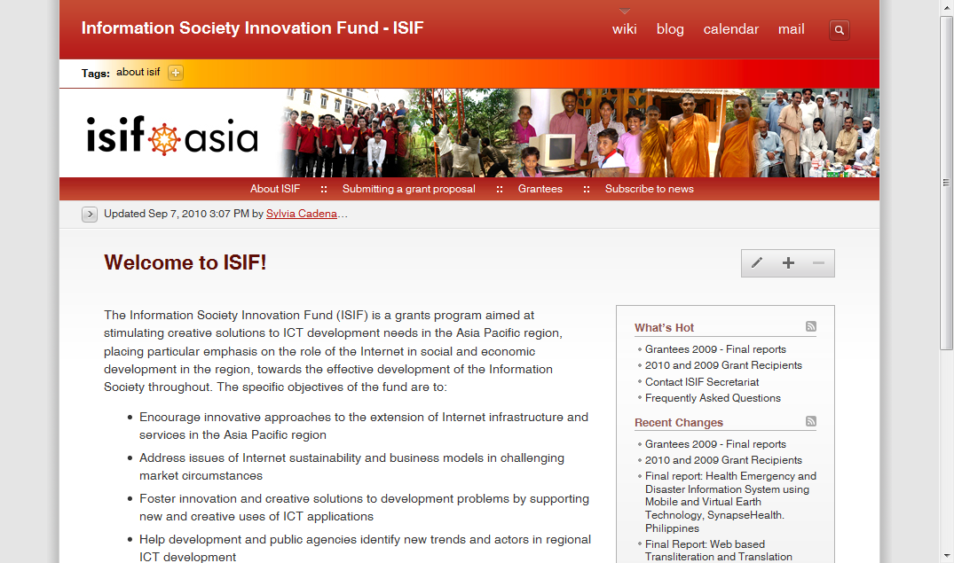
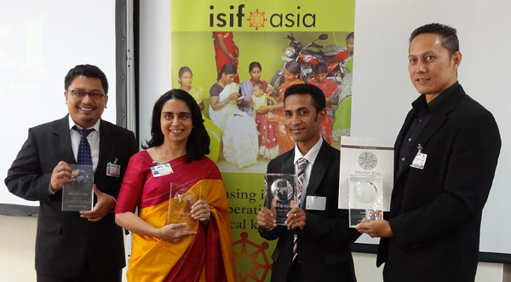

Slide 27

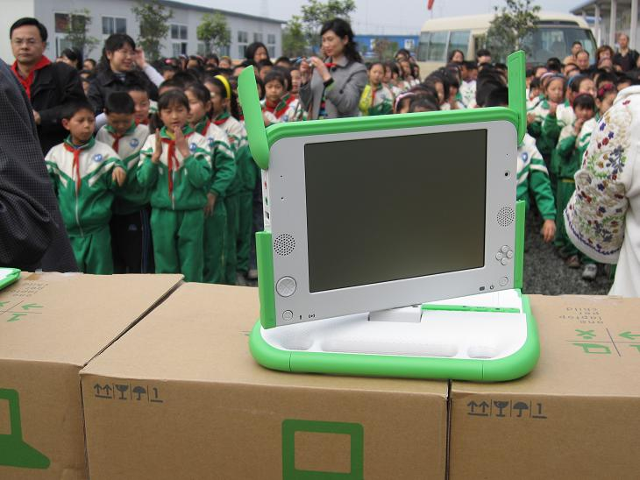
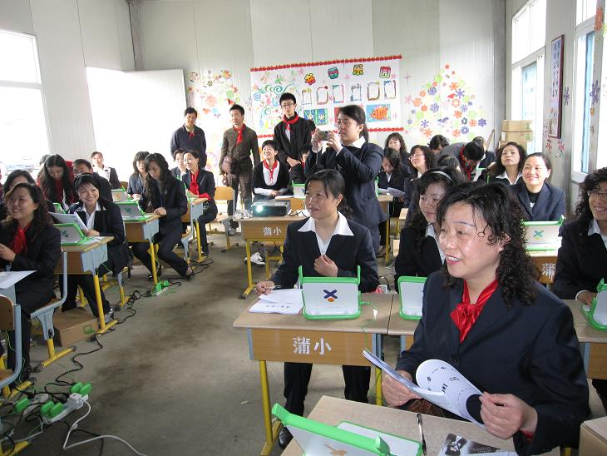
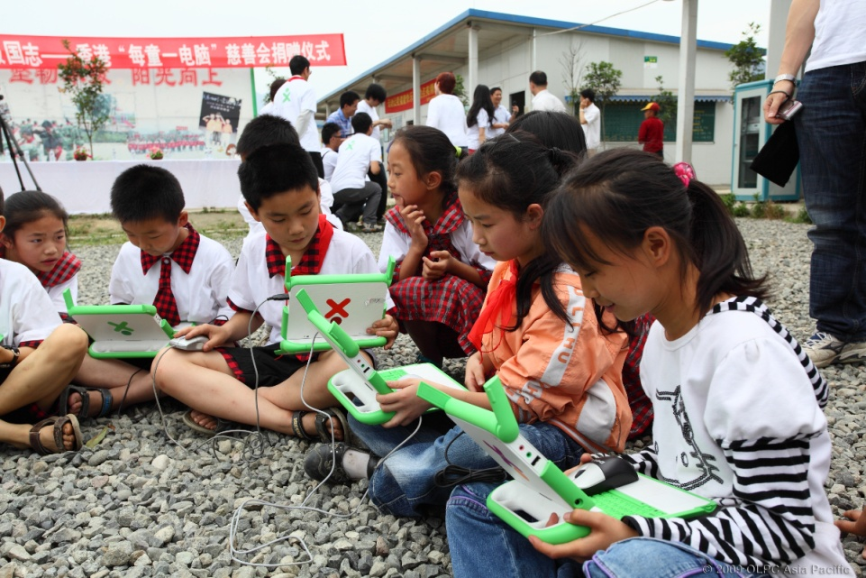
www.olpc.asia

Slide 28
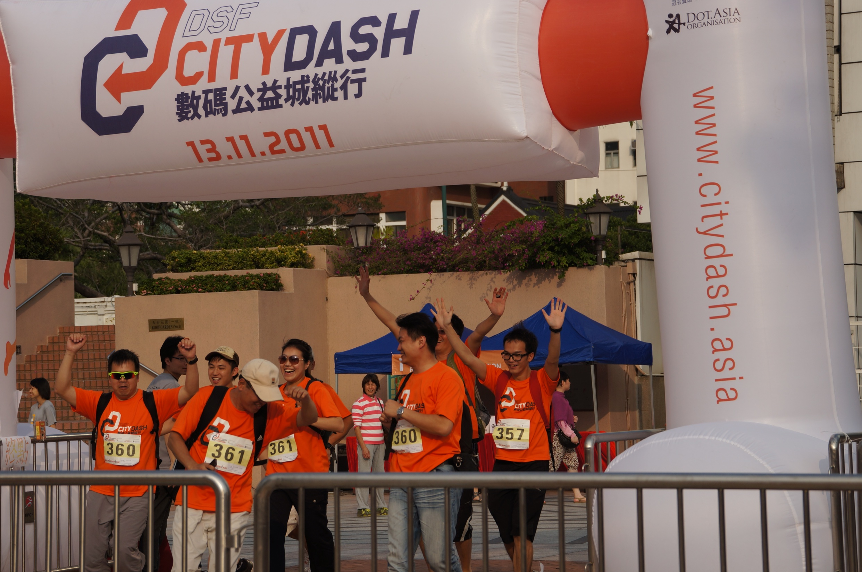
Digital Solidarity Fund (hk.DSF.Asia)

Slide 29
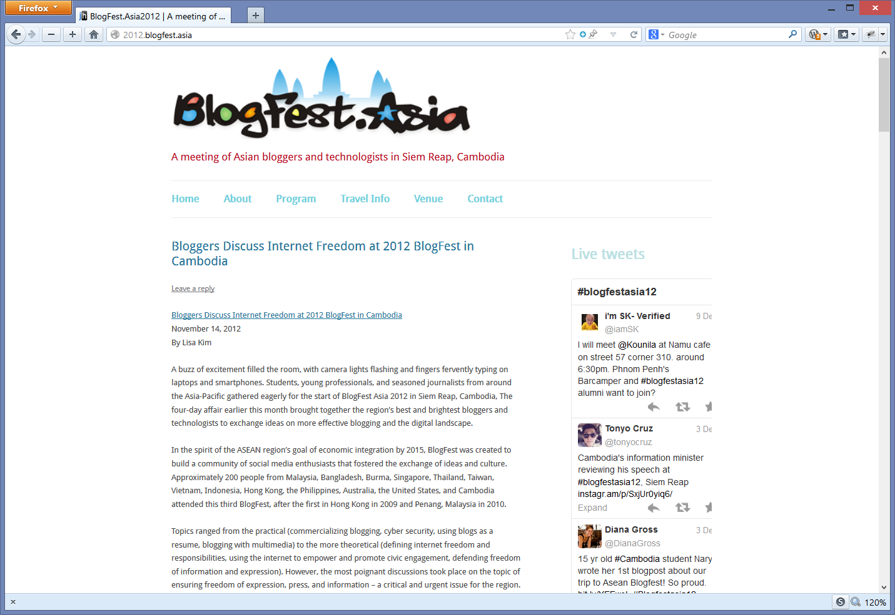

Slide 30
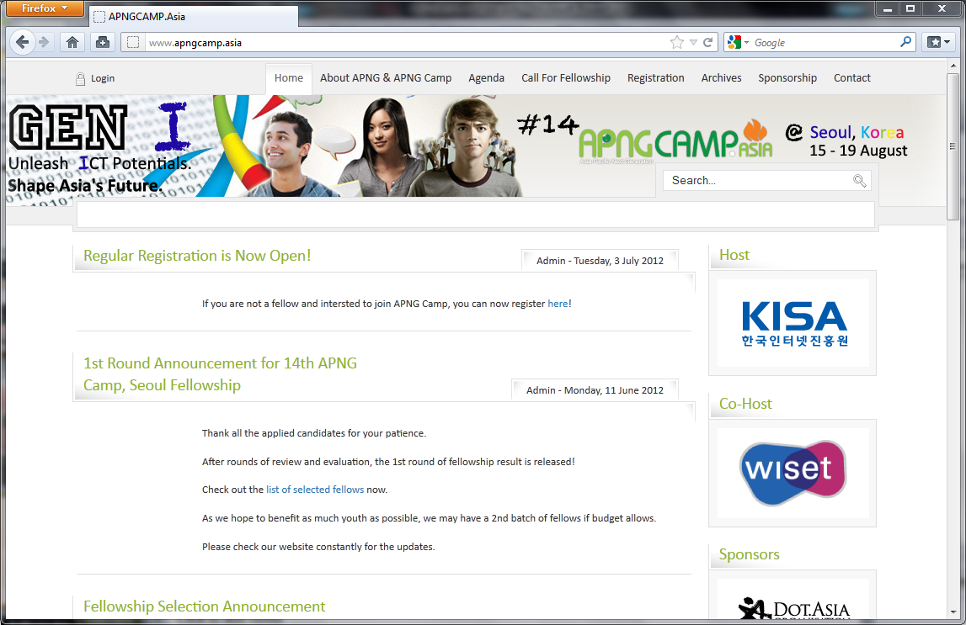
APNGCamp.Asia
14th APNG Camp
GEN I: Unleash ICT Potentials. Shape Asia’s Future.
  Date: 15 Aug (Wed.) – 19 (Sun.), 2012
  Venue: EWHA University Campus, Seoul, Korea
  Partcipant: Local Youth and 30 International Fellows

Slide 31
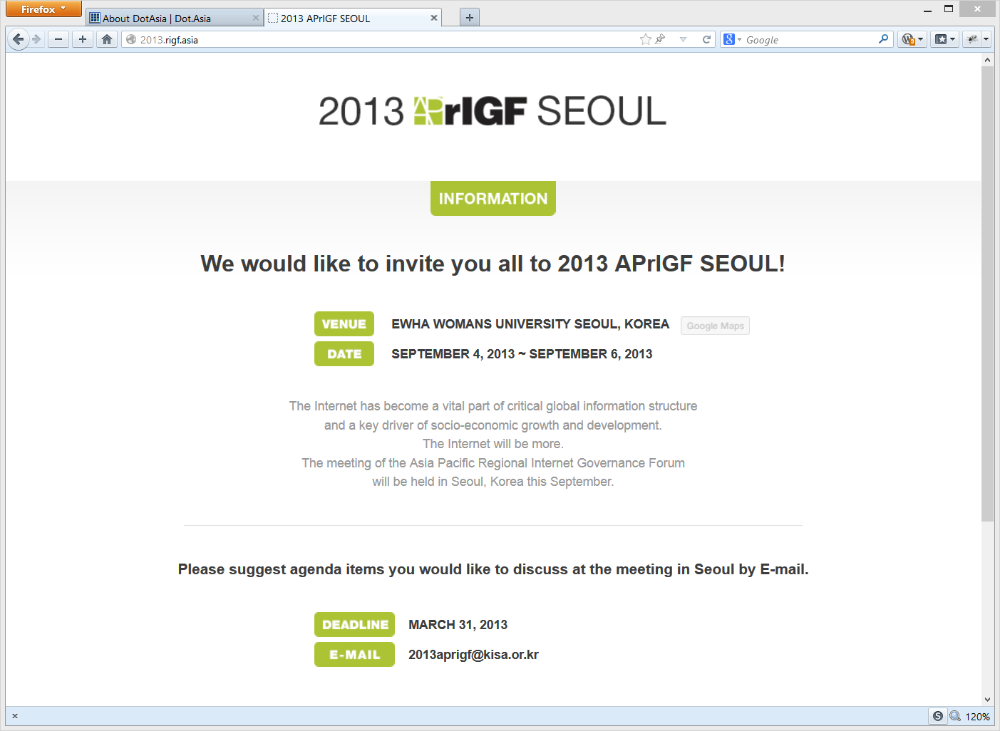

Slide 32
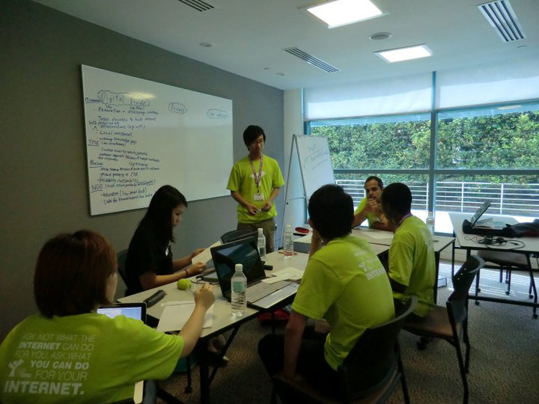
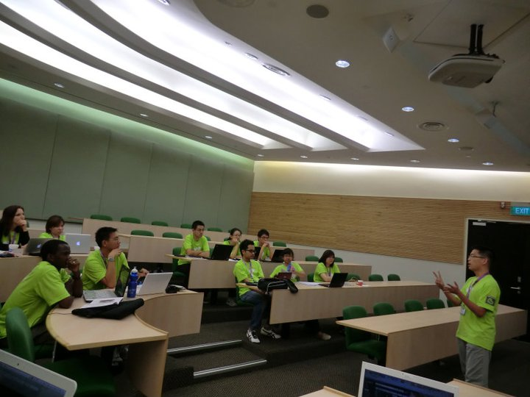
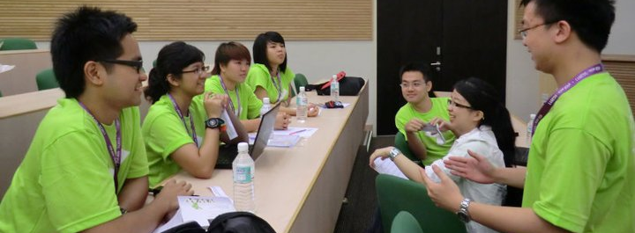
Youth IGF Camp (YIGF.Asia)

Slide 33
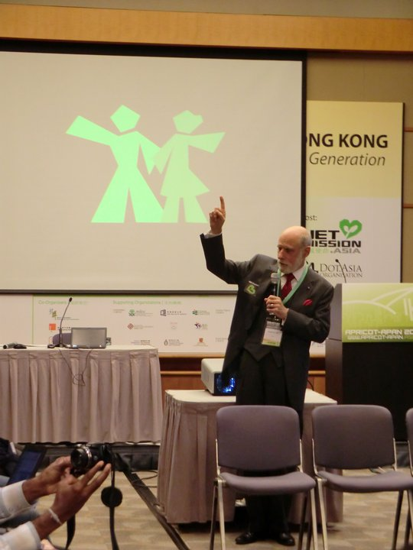
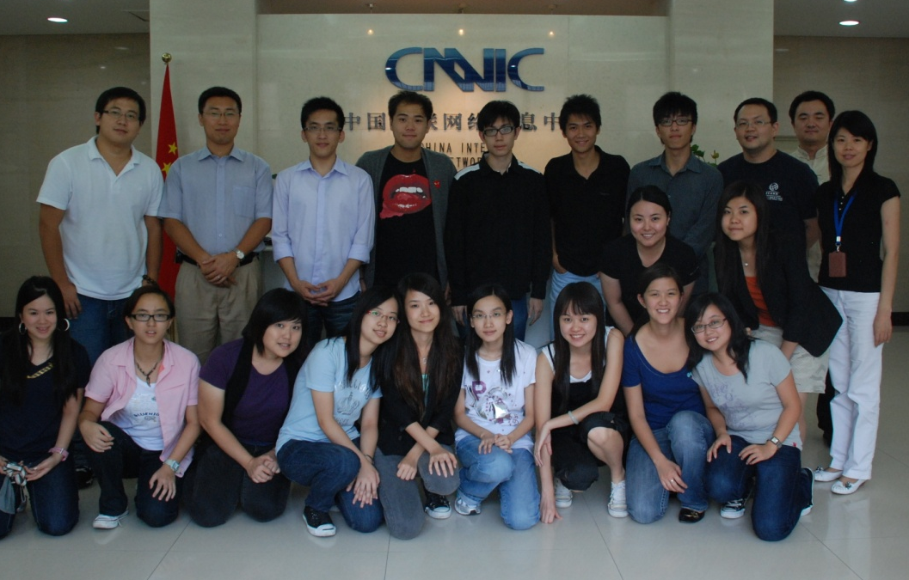
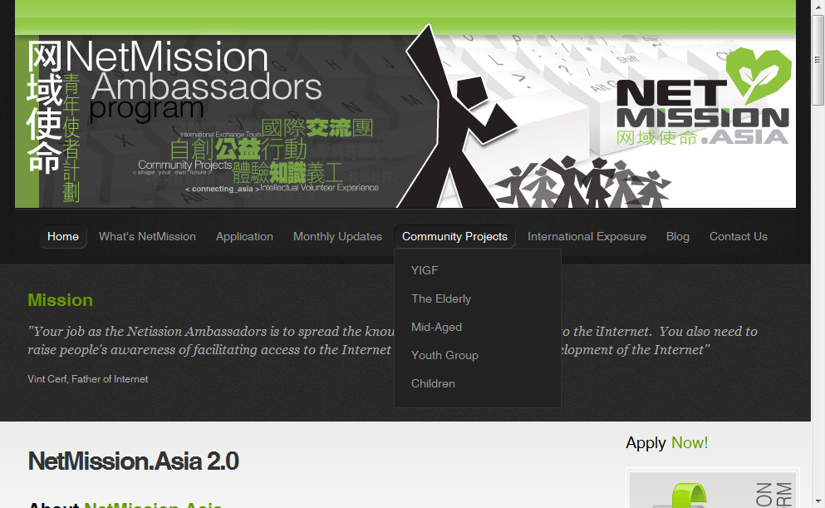
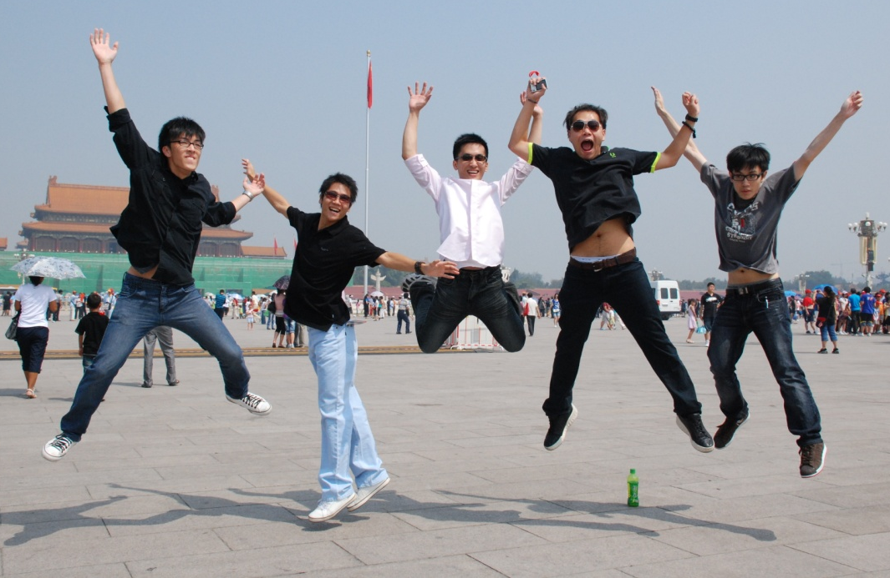
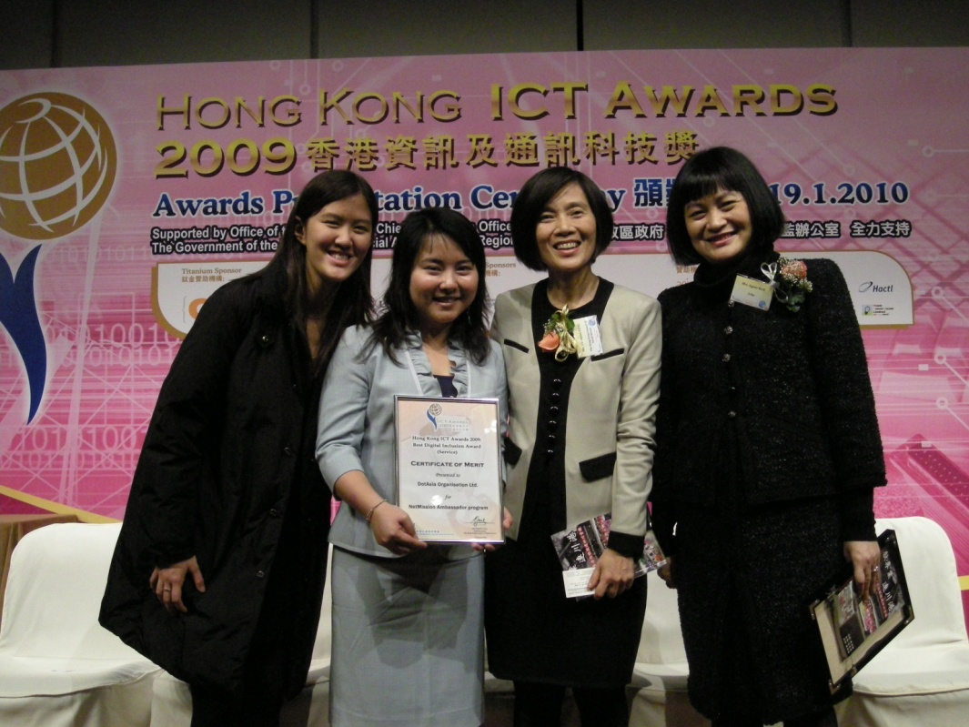
NetMission.Asia
Class of 2009
  Completed Training
  ICANN / APNG
  APNIC / APNG
Community Projects:
  Children’s Carnival
  Youth & Family → Pilot for HK gov supported large scale Internet education program (hiring 500 youth)
  Middle-Aged Women Program → Internet training for disadvantaged middle-aged women
  Elderly Survey
Youth IGF Camp

Slide 34



Slide 35
Special / Expansion Projects
Namesphere | HNET.Asia | DotKids.asia

Slide 36
.inc
.香港電訊
.studio
.art
.hkt
.asia
.网站
.richardli
.home
.广东
.pccw
.box
.kids
.app
.网店
.nowtv
.新闻
.now
.電訊盈科
.Future

Slide 37
No Application for .Asia IDN TLD
Unreasonable requirement from ICANN Applicant Guidebook
  Support letter from 60% of governments
High risk with high cost
  DotAsia considered challenging the requirements and working through the process with a .Asia IDN TLD application
  High cost (High risk) cannot be justified
Will continue to raise the issue and look to implement .Asia IDN TLDs ASAP
  DotAsia pioneered the GAC Early Warning process which we believe should be sufficient

Slide 38


Slide 39


March 2011: Migration from University of Macau
2012: Complete IANA Redelegation Process
Application for IDN ccTLD: .澳門 (.澳门)

Slide 40
Comparative Study for .MO:
 |  | Population | Internet Users | Internet Penetration | Domains Registered | Domains per 100 Users | Domain-Penetration Index
Mainland China | .cn | 1,337M | 513M | 38% | 3,350,428 | 0.68 | 1.78
Hong Kong | .hk | 7.123M | 4.89M | 69% | 235,097 | 4.80 | 6.99
Taiwan | .tw | 23.07M | 16.1M | 70% | 508,089 | 31.5 | 4.50
Singapore | .sg | 4.741M | 3.66M | 77% | 140,107 | 3.83 | 4.96
Macau | .mo | 0.573M | 0.31M | 54% | 2,320 | 0.75 | 1.39
Similar TLD Structure: com.cn / edu.hk / etc.
Stronger Requirement for 3rd-Level: xyz.com.sg
Open Registrations at 2nd-Level: abc.cn

Slide 41


Slide 42
Agenda:
Welcome Remarks
DotAsia Operations in 2012
Audited Financials (Fiscal Year 2011-2012)
Community & Special Projects
.Asia Registry Technical Updates (Afilias)
DotAsia Strategic & Operational Plans 2013
Member Resolutions (Board Elections)
Open Discussion & Closing Remarks

Slide 43
Agenda:
Welcome Remarks
DotAsia Operations in 2012
Audited Financials (Fiscal Year 2011-2012)
Community & Special Projects
.Asia Registry Technical Updates (Afilias)
DotAsia Strategic & Operational Plans 2013
Member Resolutions (Board Elections)
Open Discussion & Closing Remarks

Slide 44
DotAsia Strategic Directives 2010

Slide 45
Strategic Community Contributions
2010
Moderation on Sponsorships
Explore sustainable support
  Preference on self-sustainable projects
  Provide support in cash flow
  Aim for cost-recovery on supported projects
  Utilize loan or investment structure
Efforts & Expertise based Contributions
.Asia domain names
Website development and maintenance
Leveraging network

Slide 46
DotAsia Strategic Directives 2011

Slide 47
Multi-Dimensional Growth
2011
Expansion
  Continue to develop channel
  Launching of IDN.Asia
Horizontal Development
  Support other TLDs
  Explore New gTLD Opportunities
Vertical Development
  Vertical Integration Deregulation
  Secondary Market
Diversification
  .Asia Domains & Other Investments
  Leveraging Funding Sources

Slide 48
2011: A Year of Exploration

Slide 49
2012: A Year of Investment
Continued Investments into Expansion
Investments into New gTLDs
Investment into New Office Space

Slide 50
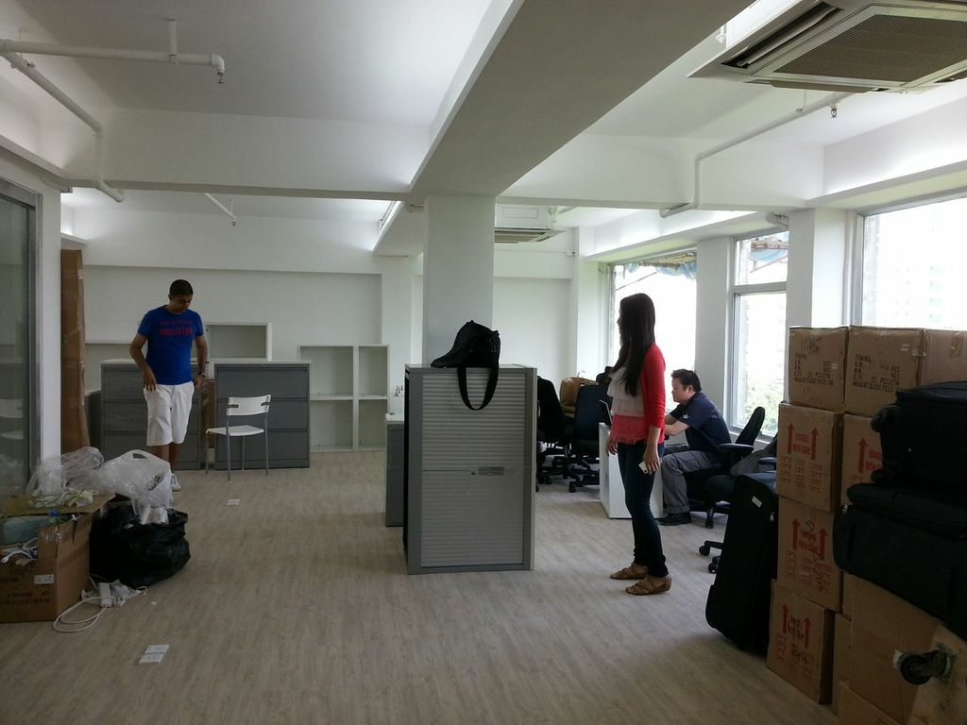
New DotAsia Office

Slide 51
2013: Year of Consolidation

Slide 52


Slide 53

DotAsia Organisation
Membership & Governance
Registry Policies & ICANN
Asia Pacific Internet Community
Registry & Techincal Operations

Slide 54

Love.from.Asia
Marketing & Promotions
Mass Media Relations
KeepClicking.Asia / Domains.Asia / 591.Asia / Community.Asia / etc.
Other Revenue & Market Development Initiatives

Slide 55

NetMission.Asia
Education & Next Generation
APNGCamp.Asia / YIGF.Asia / NetY.Asia / etc.
Youth (and Children) Engagement
Internet Governance

Slide 56

Go.Asia
General Charitable Works
Relief.Asia / GIVE.Asia / Foodbank.Asia / etc.
Volunteerism
Every Act Counts

Slide 57
Youth & Education
NetMission.Asia
YIGF.Asia
NetY.Asia
APNGCamp.Asia
OLPC.Asia
…
Charitable Initiatives
GIVE.Asia
FRD.Asia
MandelaDay.Asia
Relief.Asia
Foodbank.Asia
…
Marketing & Promotion
Domains.Asia
591.Asia
KeepClicking.Asia
Community.Asia
Love.from.Asia
…
Policies & Industry
IDN.Asia
DNSSEC.Asia
IPv6World.Asia
APrIGF.Asia
WHOIS.Asia
…

Slide 58
Strategic & Operational Plans
Community:
  Organization of Community Projects
  Expansion of Community Projects
  Proactive promotion of utilization of SCP Funds
.Asia Registry:
  Policies to mitigate registration abuses
  Additional IDN Languages launch
DotAsia Organisation
  Broaden works in New gTLDs

Slide 59
Agenda:
Welcome Remarks
DotAsia Operations in 2012
Audited Financials (Fiscal Year 2011-2012)
Community & Special Projects
.Asia Registry Technical Updates (Afilias)
DotAsia Strategic & Operational Plans 2013
Member Resolutions (Board Elections)
Open Discussion & Closing Remarks

Slide 60
Board Elections 2013
Seats up for election
  4 seats from Sponsor Member Category
  2 seat from Co-Sponsor Member Category
Development of Election Procedures
  First Draft Posted: Nov 14, 2012
  Final Procedures Posted: Dec 3, 2012
Nominations Process
  December 5, 2012 (Wed) – Nomination Period Begins
  January 9, 2013 (Wed) – Nomination Period Ends

Slide 61
Highlights of Procedures
Nominations & Voting Process (via email)
Sub-Regions (Sponsor Category):
  At least 1 member from each of the 4 Sub-Regions
    North and Northeast Asia
    South and Southeast Asia
    Middle East, Asia Minor and Eurasia
    Australia and Pacific Asia
  Remaining members already fulfil requirement
Vacant Seats for Co-Sponsor Category
  2 Seats vacant
  1 seat for 1-year term, 1 seat for 2-year term

Slide 62
Nominations Recieved
Candidates Nominated: 6*
  Sponsor Category: 4
  Co-Sponsor Category: 2*
Late second received Jan 10, 2013 16:01 UTC
Candidate | Nominated by: | Seconded by:
Atsushi ENDO | SGNIC (.SG) | DotPH (.PH)
Choon Sai LIM | JPRS (.JP) | DotPH (.PH)
Dr. Xiaodong LEE | CNNIC (.CN) | JPRS (.JP)
Dr. THAM Yiu Kwok | SGNIC (.SG) | Datacom (.MN)
Candidate | Nominated by: | Seconded by:
Ching CHIAO | SANOG | APNIC
Tommy MATSUMOTO* | APNG | SANOG

Slide 63
Voting Process
Sponsor Members
  Number of candidates (4) standing for election in the Sponsor Member category is equal to the number of vacancies in the category (4)
  No voting required
Co-Sponsor Members
  Number of candidates (2) standing for election in the Sponsor Member category is equal to the number of vacancies in the category (2)
  No voting required

Slide 64
Proposed Member Resolutions 1&2
AGM2013 Resolution 1
  To accept the Board Elections 2013 results in the election of the following duly nominated candidates:
    Atsushi ENDO (re-elected)
    Choon Sai LIM (re-elected)
    Dr. Xiaodong LEE (re-elected)
    Dr. THAM Yiu Kwok (re-elected)
    Ching CHIAO (newly elected)
AGM2013 Resolution 2
  To accept the late seconding received Jan 10, 2013 16:01 UTC (where deadline was Jan 9, 2013) for Tommy MATSUMOTO, which confirms re-election
    Tommy MATSUMOTO (re-elected)

Slide 65
Drawing of Lots to determine Term Length of Co-Sponsor Member Directors
According to the Board Elections Procedures 2013 (http://dot.asia/policies/DotAsia-BoardElections2013_COMPLETE.pdf) with reference to Article 40 (d) of the the DotAsia M&A (http://dot.asia/policies/DotAsia%20M&A%202009-06-26.pdf), for the determination of the terms of the Co-Sponsor Member Category Board Members, "the elected Director who received the greater number of votes shall serve on the board for 2 years while the other elected Director shall serve for 1 year. In case of an equal number of votes, or if no voting is required, the election shall be decided by way of lot."

Slide 66
Complete Board Elections 2013 Results
Elected Board Members: (serving until AGM 2015)
  Atsushi ENDO – North & North East Asia
  LIM Choon Sai – South & South East Asia
  Dr. THAM Yiu Kwok – North & North East Asia
  Xiaodong LEE – North & North East Asia
  Ching CHIAO – North & North East Asia
Elected Board Member: (serving until AGM 2014)
  Tommy MATSUMOTO – North & North East Asia
Other Elected Board Members: (serving until AGM 2014)
  Stafford GUEST – Australia and Pacific Asia
  Alireza SALEH – Middle East, Asia Minor and Eurasia
  Dr. SIR Jae-Chul – North & North East Asia
  Joel DISINI – South & South East Asia

Slide 67
Thank you Everyone for your Continued Support

Slide 68
Joint AP* DotAsia Dinner
6:00PM @ Shangri-La Lobby
www.inITALY.asia

Slide 69
Every .Asia Domain
Contributes to Internet Development in Asia
Edmon Chung <edmon@registry.asia>

Slide 70
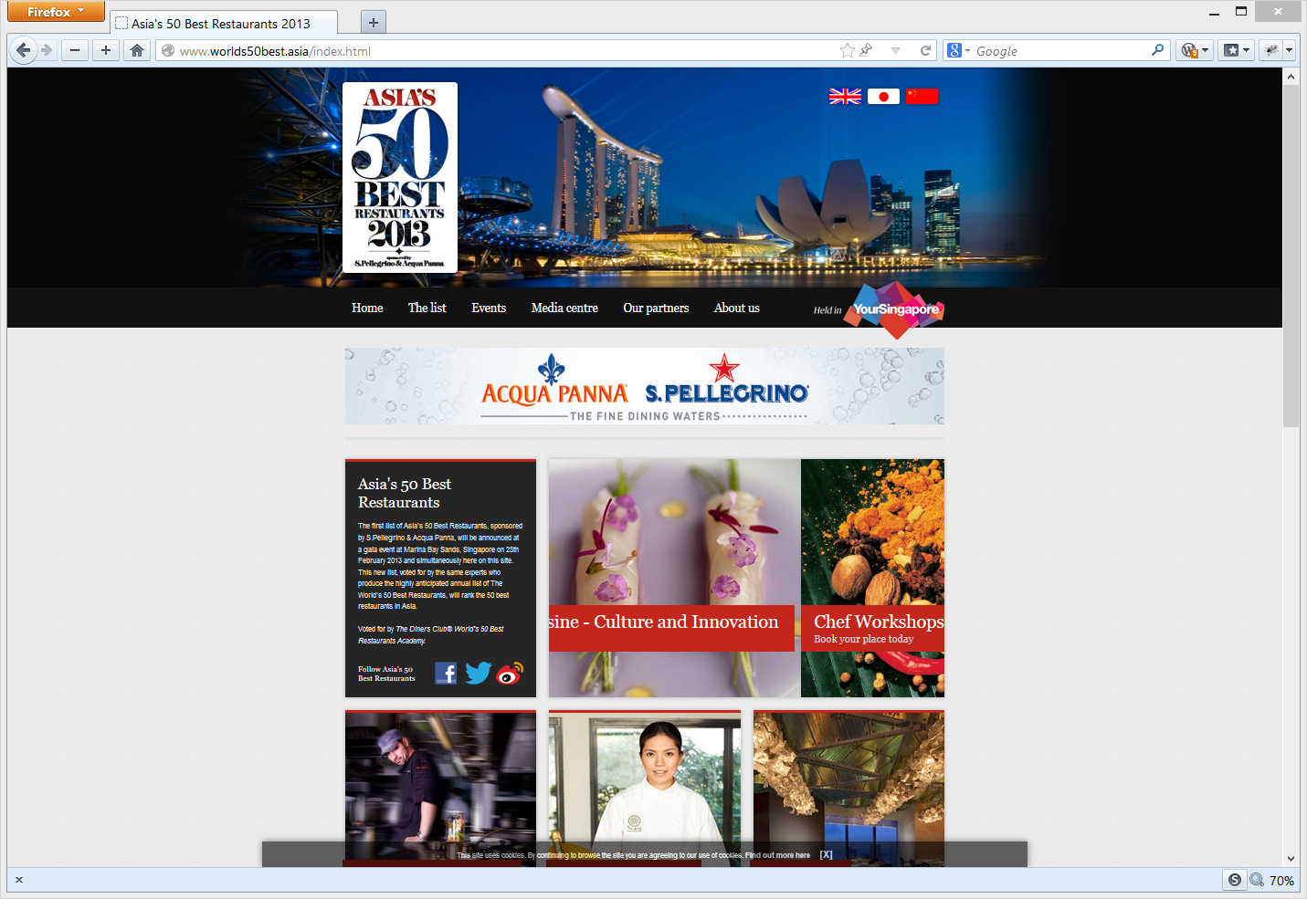
worlds50best.asia

