Slide 1


.ASIA Update: Afilias
DotAsia AGM
March 1, 2015
Joseph Yee

Slide 2
Agenda
.asia in 2014 – a review
New DNS Node in Asia region
Update on Registry systems, WHOIS, Registrars
Anti-Abuse Highlight
Threats to .asia
Plans for 2015
Q and A

Slide 3
.asia in 2014 – a review
Congratulations to DotAsia on your 7 year anniversary in 2014! Afilias is honored to be your technical service provider and a part of your exciting journey.
100% uptime: There is no unexpected outage in 2014
Big uptake on number of registrars (14, about 9%), Afilias’ registrar onboarding system ORMS, helps both registrars and ASIA
Successful promotion in 2014
New DNS Node in Tokyo, Japan
DotAsia and Afilias expanded anti-abuse efforts

Slide 4
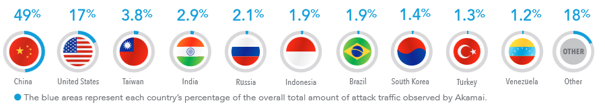
Where do DNS attacks originate?
Asia: 65%
Americas: 20%
Europe: 10%

Slide 5
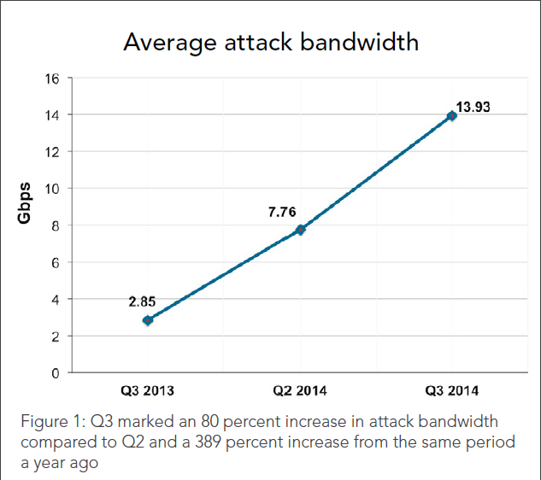
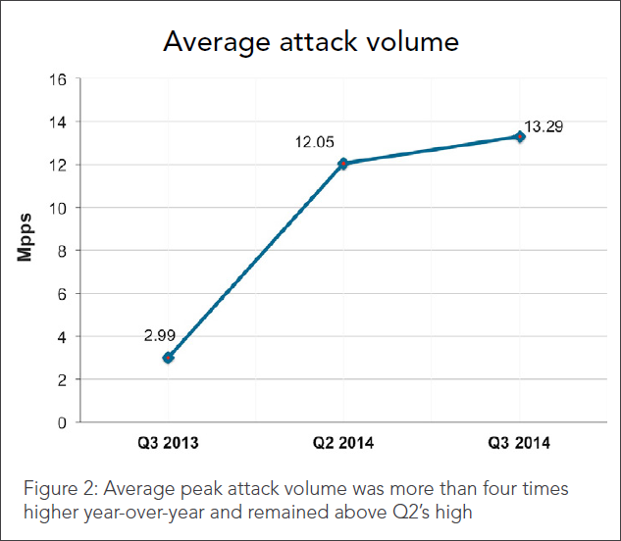
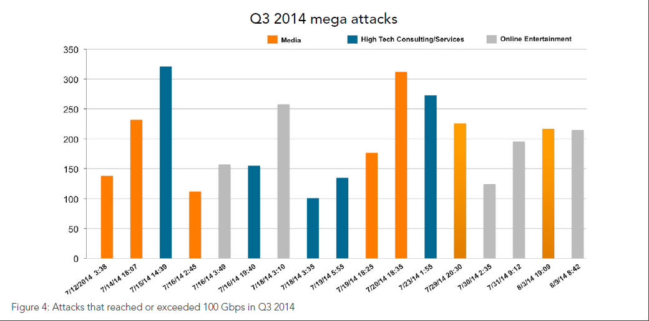
DDOS attacks are growing dramatically
Source: Akamai
Source: Akamai
Source: Akamai

Slide 6
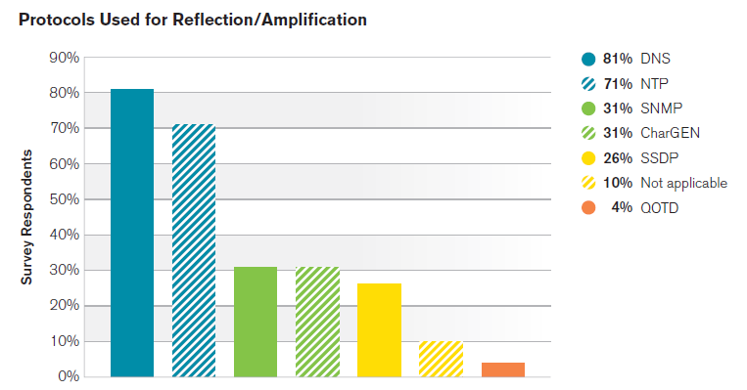
DNS is most used for attacks
Source: Arbor

Slide 7
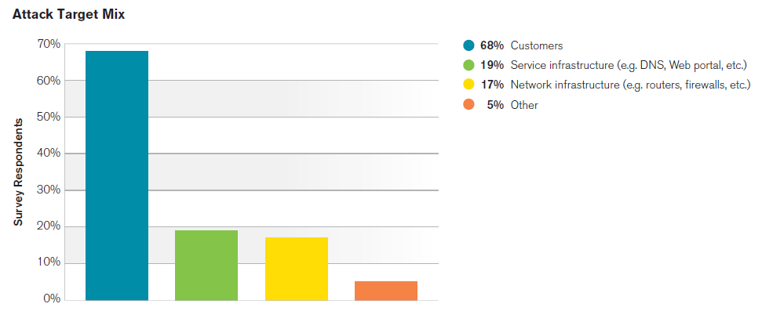
36% of attacks affect our kind of infrastructure
Source: Arbor

Slide 8
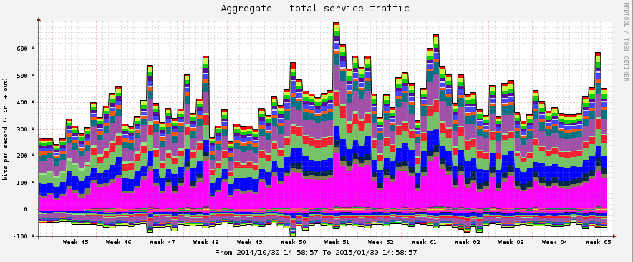
We are getting attacked frequently and for longer durations
Six attack attempts (one sustained for a week). DNS infrastructure responded satisfactorily. No impact to resolution.

Slide 9
DNS Queries Peak
Notes:
Another dimension on Afilias’ DNS sustaining attack. On busiest day of each month, some day we experienced around 100 millions queries. In August, one single day we experienced over 167 million queries.
After all these, there is no issue in resolving ASIA domain names.

Slide 10
Increasing DNS & Resolution Capacity
Afilias increasing DNS capacity 30x – 2011-2015
Upgrading all nodes – more memory, more routers, more bandwidth
West Coast MKII node deployment in progress
  Will serve West Coast USA & Pacific Rim
  Adding more micro-nodes
    Already deploy 70+ micro-nodes worldwide
    Building ability to add quickly based on network topology and traffic vectors

Slide 11
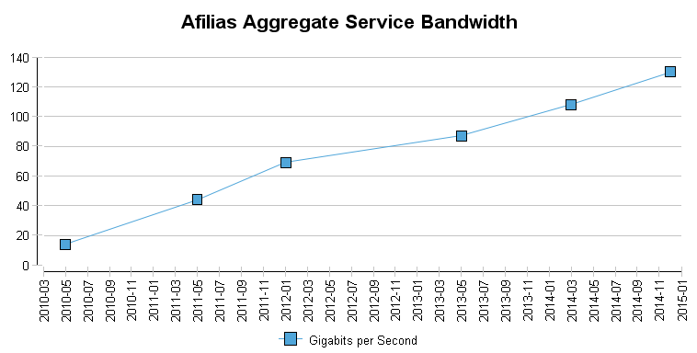
Afilias capacity large and growing

Slide 12
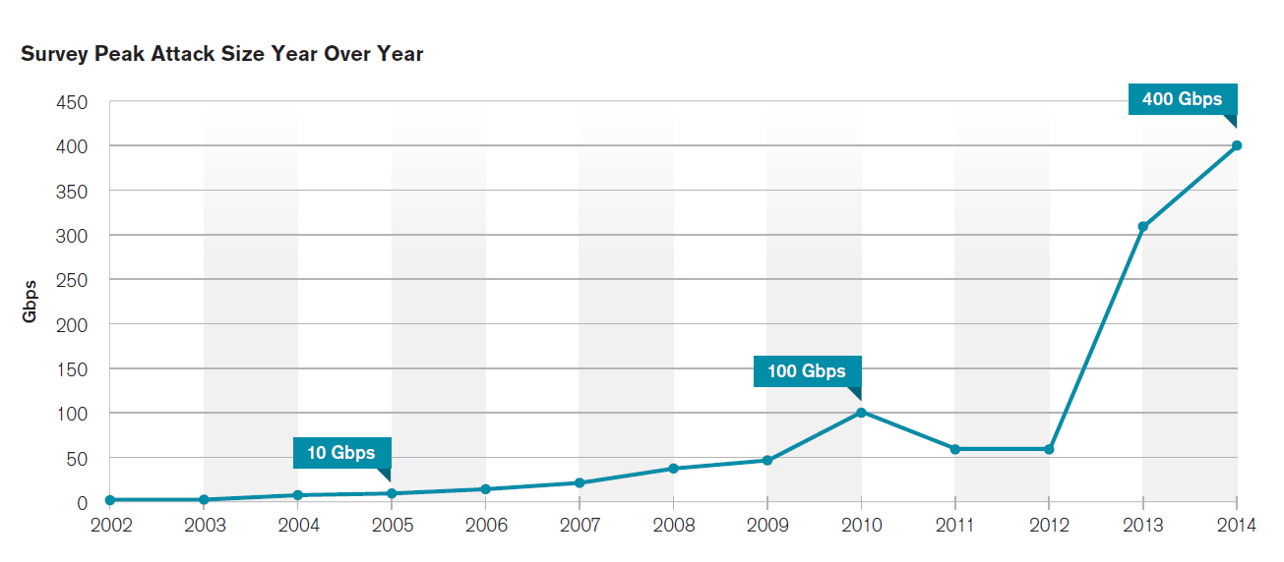
Against this reality…
Source: Arbor

Slide 13
New DNS Node
In 2014, Afilias deployed new DNS node in Tokyo, Japan with focus of traffic in Asia
The node in HK has 2G capacity, the node in Tokyo has 20G
Afilias DNS capacity for .ASIA increases from 66G to 86G (~23% increase)
With partners (peering), the total capacity increases from 88G to 108G

Slide 14
Registry Systems Stay
Nimble & Scalable
Average: < 30ms ICANN New gTLD Requirement: 4000ms

Slide 15
Whois - Fastest In The Industry
ASIA 2014 Average: 18.91ms ICANN Requirement: 1500ms

Slide 16
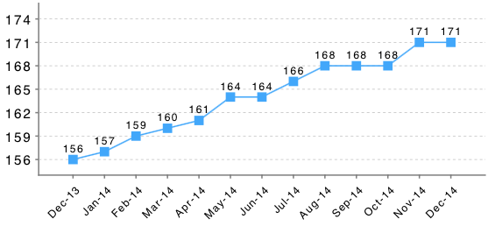
More Registrars…
171 and counting
Increasing Numbers of New Registrars – 171 now; 14 more Registrars than last year, 122 more in the pipeline
Source: Afilias tracking files

Slide 17
Plans for 2015
Focus on China
Work with .ASIA on setting infrastructure in China
Continue to work with .ASIA on promotion where Afilias reduces fee on promotion sales as well

Slide 18
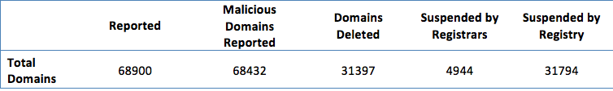
Anti-Abuse Highlight
In 2014, 68900 domains reported, 68702 are spam, 68 are phishing, 130 are malware

Slide 19
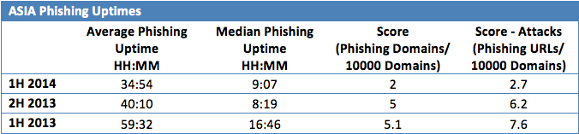
ASIA Phishing Uptime
We worked with ASIA together to bring down phishing site quick, average phishing site uptime (in ASIA) in 2014 is around 35 hours, compared to 59 hours in 2013

Slide 20
.ASIA Ranking
Notes:
The Spamhaus ranking for ASIA has dropped from 13, at its peak in July, to 30 in December 2014.

Slide 21
Threats to .asia
Promotion increases volume but also lures abusive registrants
There 22% increase on malware related emails, and high uptake in unique URL for phishing
DotASIA and Afilias will continue to work together, along with registrars, to tackle domains used in abusive manner.
Criminals always seek for easy targets and exploit weakness, Afilias and DotASIA will constantly check, monitor, and evolve tactics and techniques to combat bad behaviors.

Slide 22
Afilias support summary
Registry excellence—beating SLA’s 100% of the time
DNS: 100% uptime despite increasingly hostile environment
  Advanced DDoS protection; constant capacity increases
Security: driving abuse out of .ASIA with daily intervention
Constant upgrades
  Registry: AWIP, others…?
  ORMS: Online Registry Management System
Partnership: sharing the cost of promotions that drive growth
Notes:
AWIP = Additional WHOIS Information

Slide 23
Questions?

